Slide 1
The market forces of Demand and Supply

Slide 2
Supply and Demand Together
Three steps to analyzing changes in equilibrium
Decide whether the event shifts the supply curve, the demand curve, or, in some cases, both curves
Decide whether the curve shifts to the right or to the left
Use the supply-and-demand diagram
Compare the initial and the new equilibrium
Effects on equilibrium price and quantity
Notes:
Step 1 requires knowing all of the things that can shift D and S—the non-price determinants of demand and of supply.

Slide 3
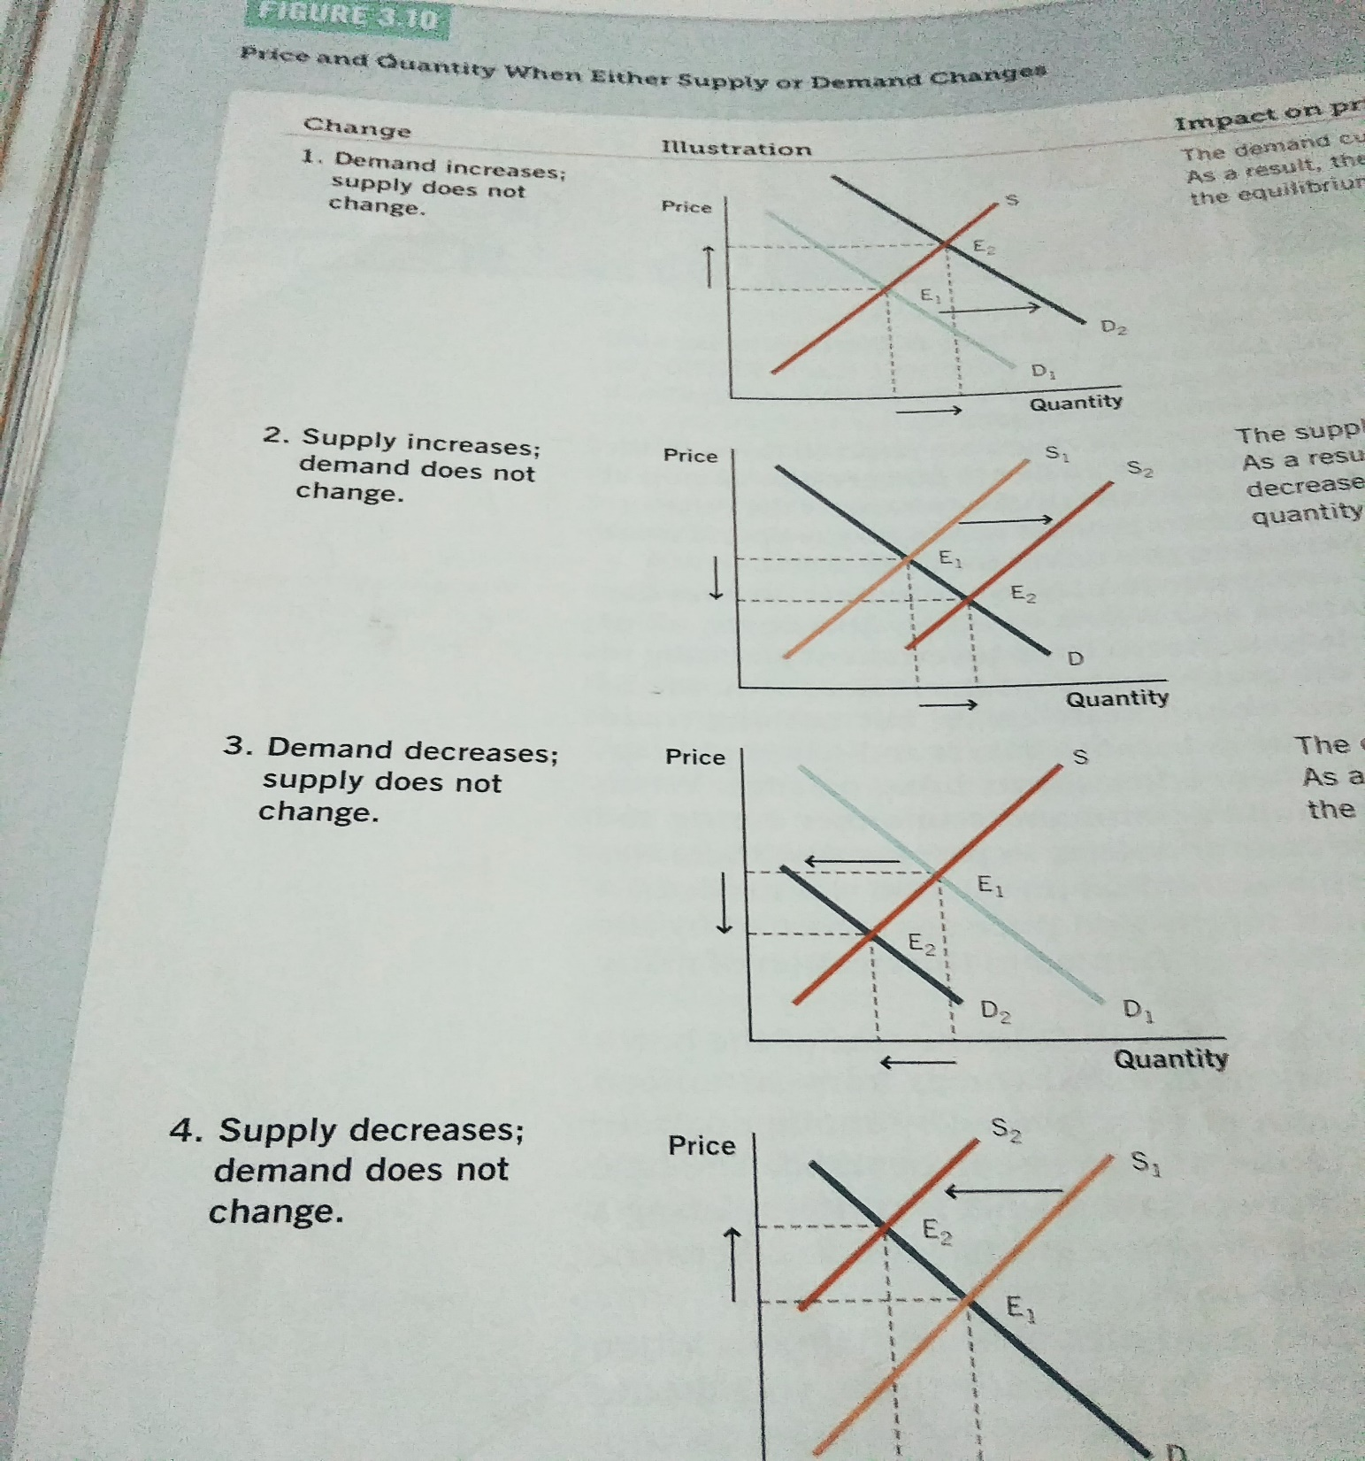

Slide 4
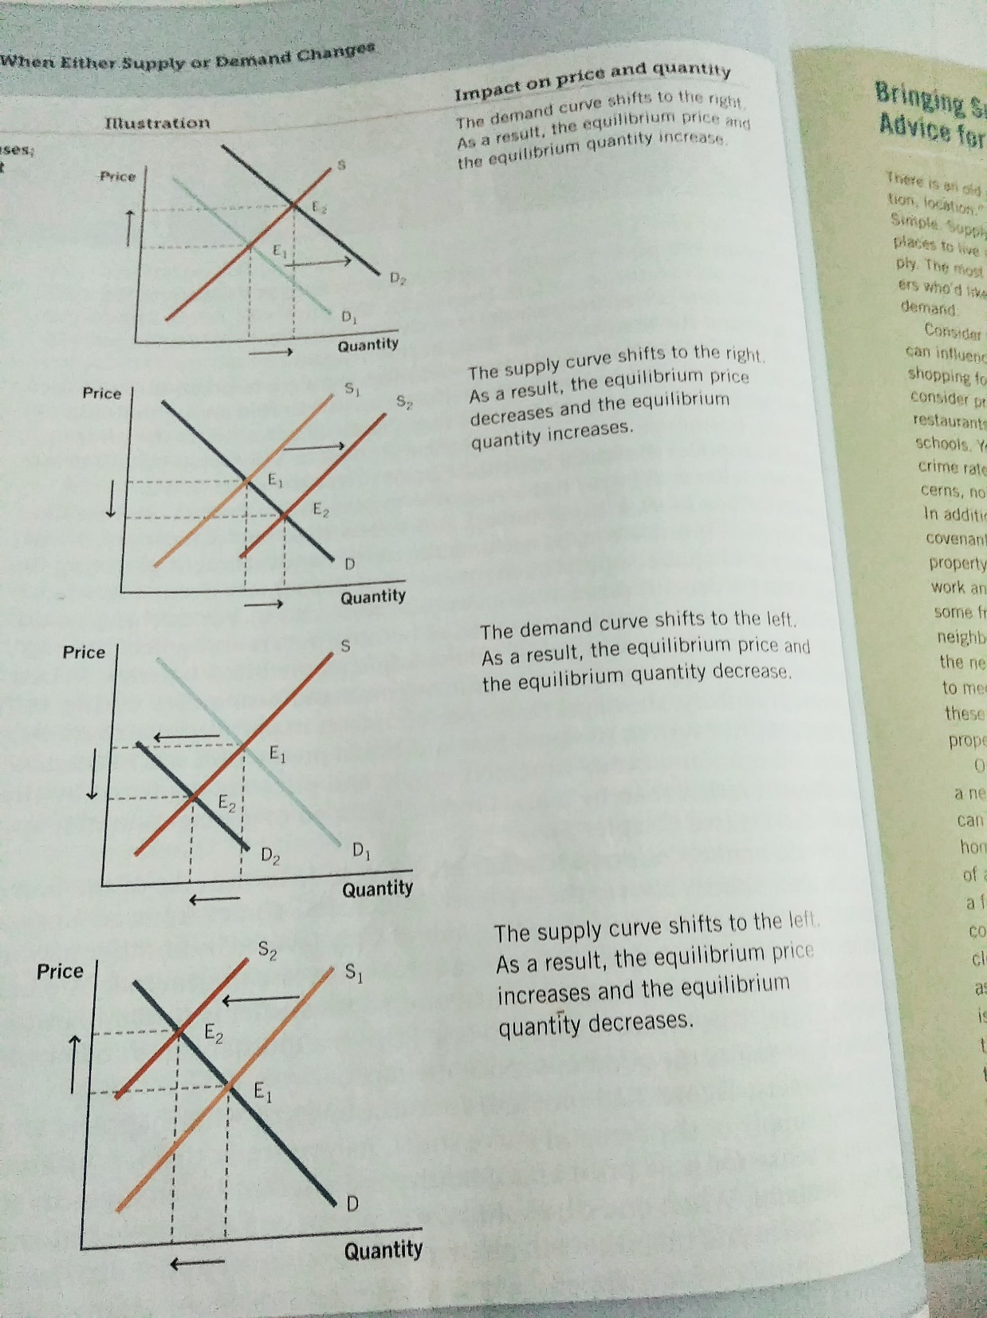

Slide 5
Shift vs. Movement Along Curve
Change in supply:
A shift in the S curve
Occurs when a non-price determinant of supply changes (like technology or costs)
Change in the quantity supplied:
A movement along a fixed S curve
Occurs when P changes
Notes:
Remind your class often the difference between movements along a curve (change in quantity caused by a change in price) and shifts (caused by changes in the non-price determinants).
“Supply” refers to the position of the supply curve, while “quantity supplied” refers to the specific amount that producers are willing and able to sell at a specific price.
If you’d like to be a rebel, delete this slide and the next and all references to the jargon it contains, and just use the terms “movement along a curve” and “shift in a curve.” Note, however, that this is not the official recommendation of Cengage Learning or Dr. Mankiw.
If you’d like to cover this slide but make it move more quickly, for this slide and the next, delete the text starting with “occurs when” and give the information to your students verbally or rely on them to read it in the textbook.

Slide 6
Shift vs. Movement Along Curve
Change in demand:
A shift in the D curve
Occurs when a non-price determinant of demand changes (like income or # of buyers)
Change in the quantity demanded:
A movement along a fixed D curve
Occurs when P changes
Notes:
Similarly, “demand” refers to the position of the demand curve, while “quantity demanded” refers to the specific amount that consumers are willing and able to buy at a specific price.

Slide 7
EXAMPLE: The Market for Hybrid Cars
P
price of hybrid cars
S₁
P₁
D₁
Q
Q₁
quantity of hybrid cars

Slide 8
EXAMPLE 1: A Shift in Demand
EVENT TO BE ANALYZED: Increase in the price of gas.
STEP 1: D curve shifts
because price of gas affects demand for hybrids. (S curve does not shift, because price of gas does not affect cost of producing hybrids)
STEP 2: D shifts right
because high gas price makes hybrids more attractive relative to other cars.
STEP 3: The shift causes an increase in price and quantity of hybrid cars.
P
S₁
P₂
P₁
D₁
D₂
Q
Q₁
Q₂
Notes:
Notice: When P rises, producers supply a larger quantity of hybrids, even though the S curve has not shifted.
Always be careful to distinguish b/w a shift in a curve and a movement along the curve.

Slide 9
EXAMPLE 2: A Shift in Supply
EVENT: New technology reduces cost of producing hybrid cars.
STEP 1: S curve shifts because event affects cost of production. (D curve does not shift, because production technology is not one of the factors that affect demand)
STEP 2: S shifts right because event reduces cost, makes production more profitable at any given price.
STEP 3: The shift causes price to fall and quantity to rise.
P
S₁
S₂
P₁
P₂
D₁
Q
Q₁
Q₂

Slide 10
EXAMPLE 3: A Shift in Both Supply and Demand
EVENTS: Price of gas rises AND new technology reduces production costs
STEP 1: Both curves shift.
STEP 2: Both shift to the right.
STEP 3: Q rises, but the effect on P is ambiguous:
If demand increases more than supply, P rises.
P
S₁
S₂
P₂
P₁
D₁
D₂
Q
Q₁
Q₂

Slide 11
EXAMPLE 3: A Shift in Both Supply and Demand
EVENTS: Price of gas rises AND new technology reduces production costs
STEP 3: Q rises, but the effect on P is ambiguous:
But if supply increases more than demand, P falls.
P
S₁
S₂
P₁
P₂
D₁
D₂
Q
Q₁
Q₂

Slide 12
What happens to price and quantity when supply or demand shifts?
 | No change in Supply | An Increase in supply | A decrease in supply
No change in demand | P Same | P | P
 | Q Same | Q | Q
An increase in demand | P | P | P
 | Q | Q | Q
A decrease in demand | P | P | P
 | Q | Q | Q

Slide 13
Analyse the changes in Equilibrium
Event A : Hot weather in Summer. What happens to demand curve? What Happens to supply curve? Explain which curve shifts?
Event B: There was heavy flood which destroys the sugar cane crop and drives up the price of sugars. How does this affect the market for ice creams? What happens to demand curve? What Happens to supply curve? Explain which curve shifts?
When both events happens together in a year. How does this affect market for ice creams?

